Slide 1

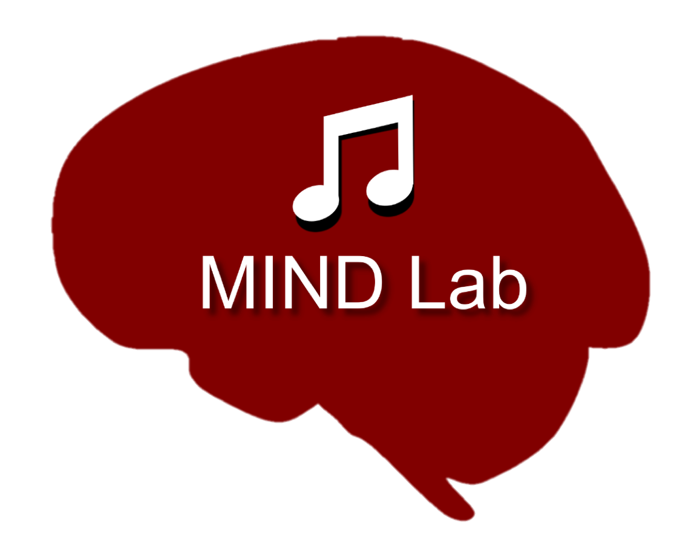
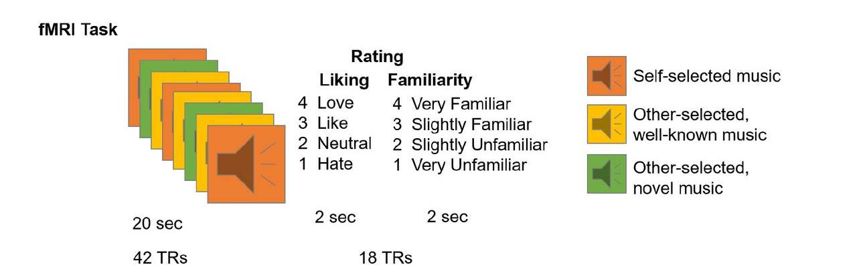
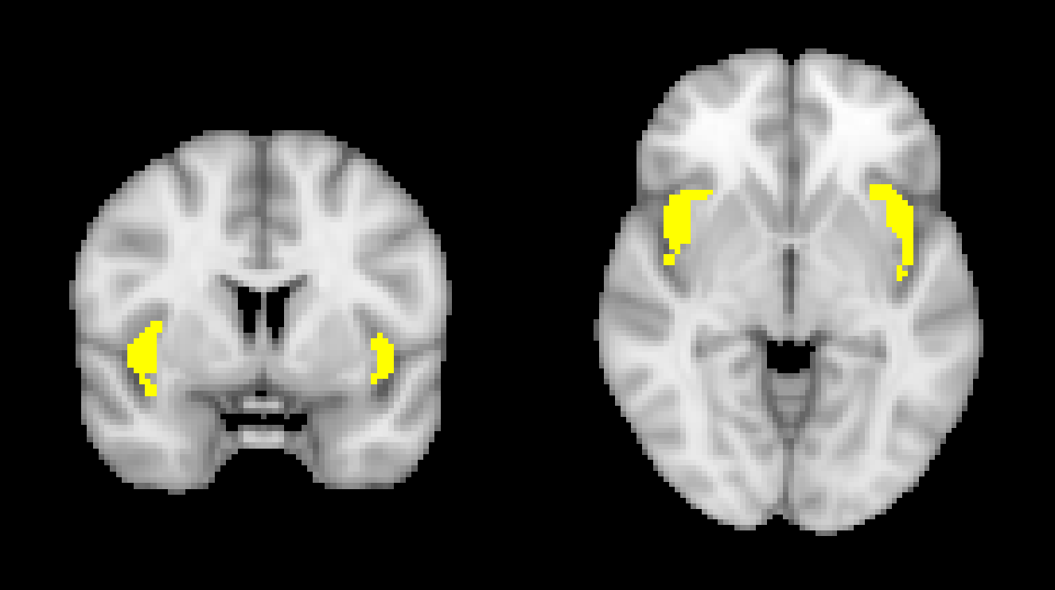
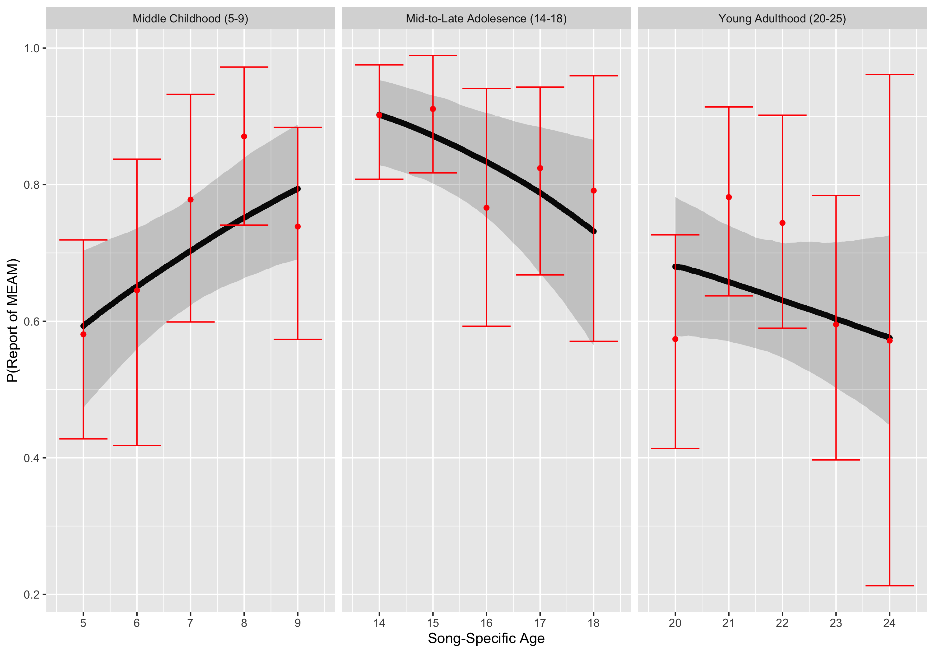
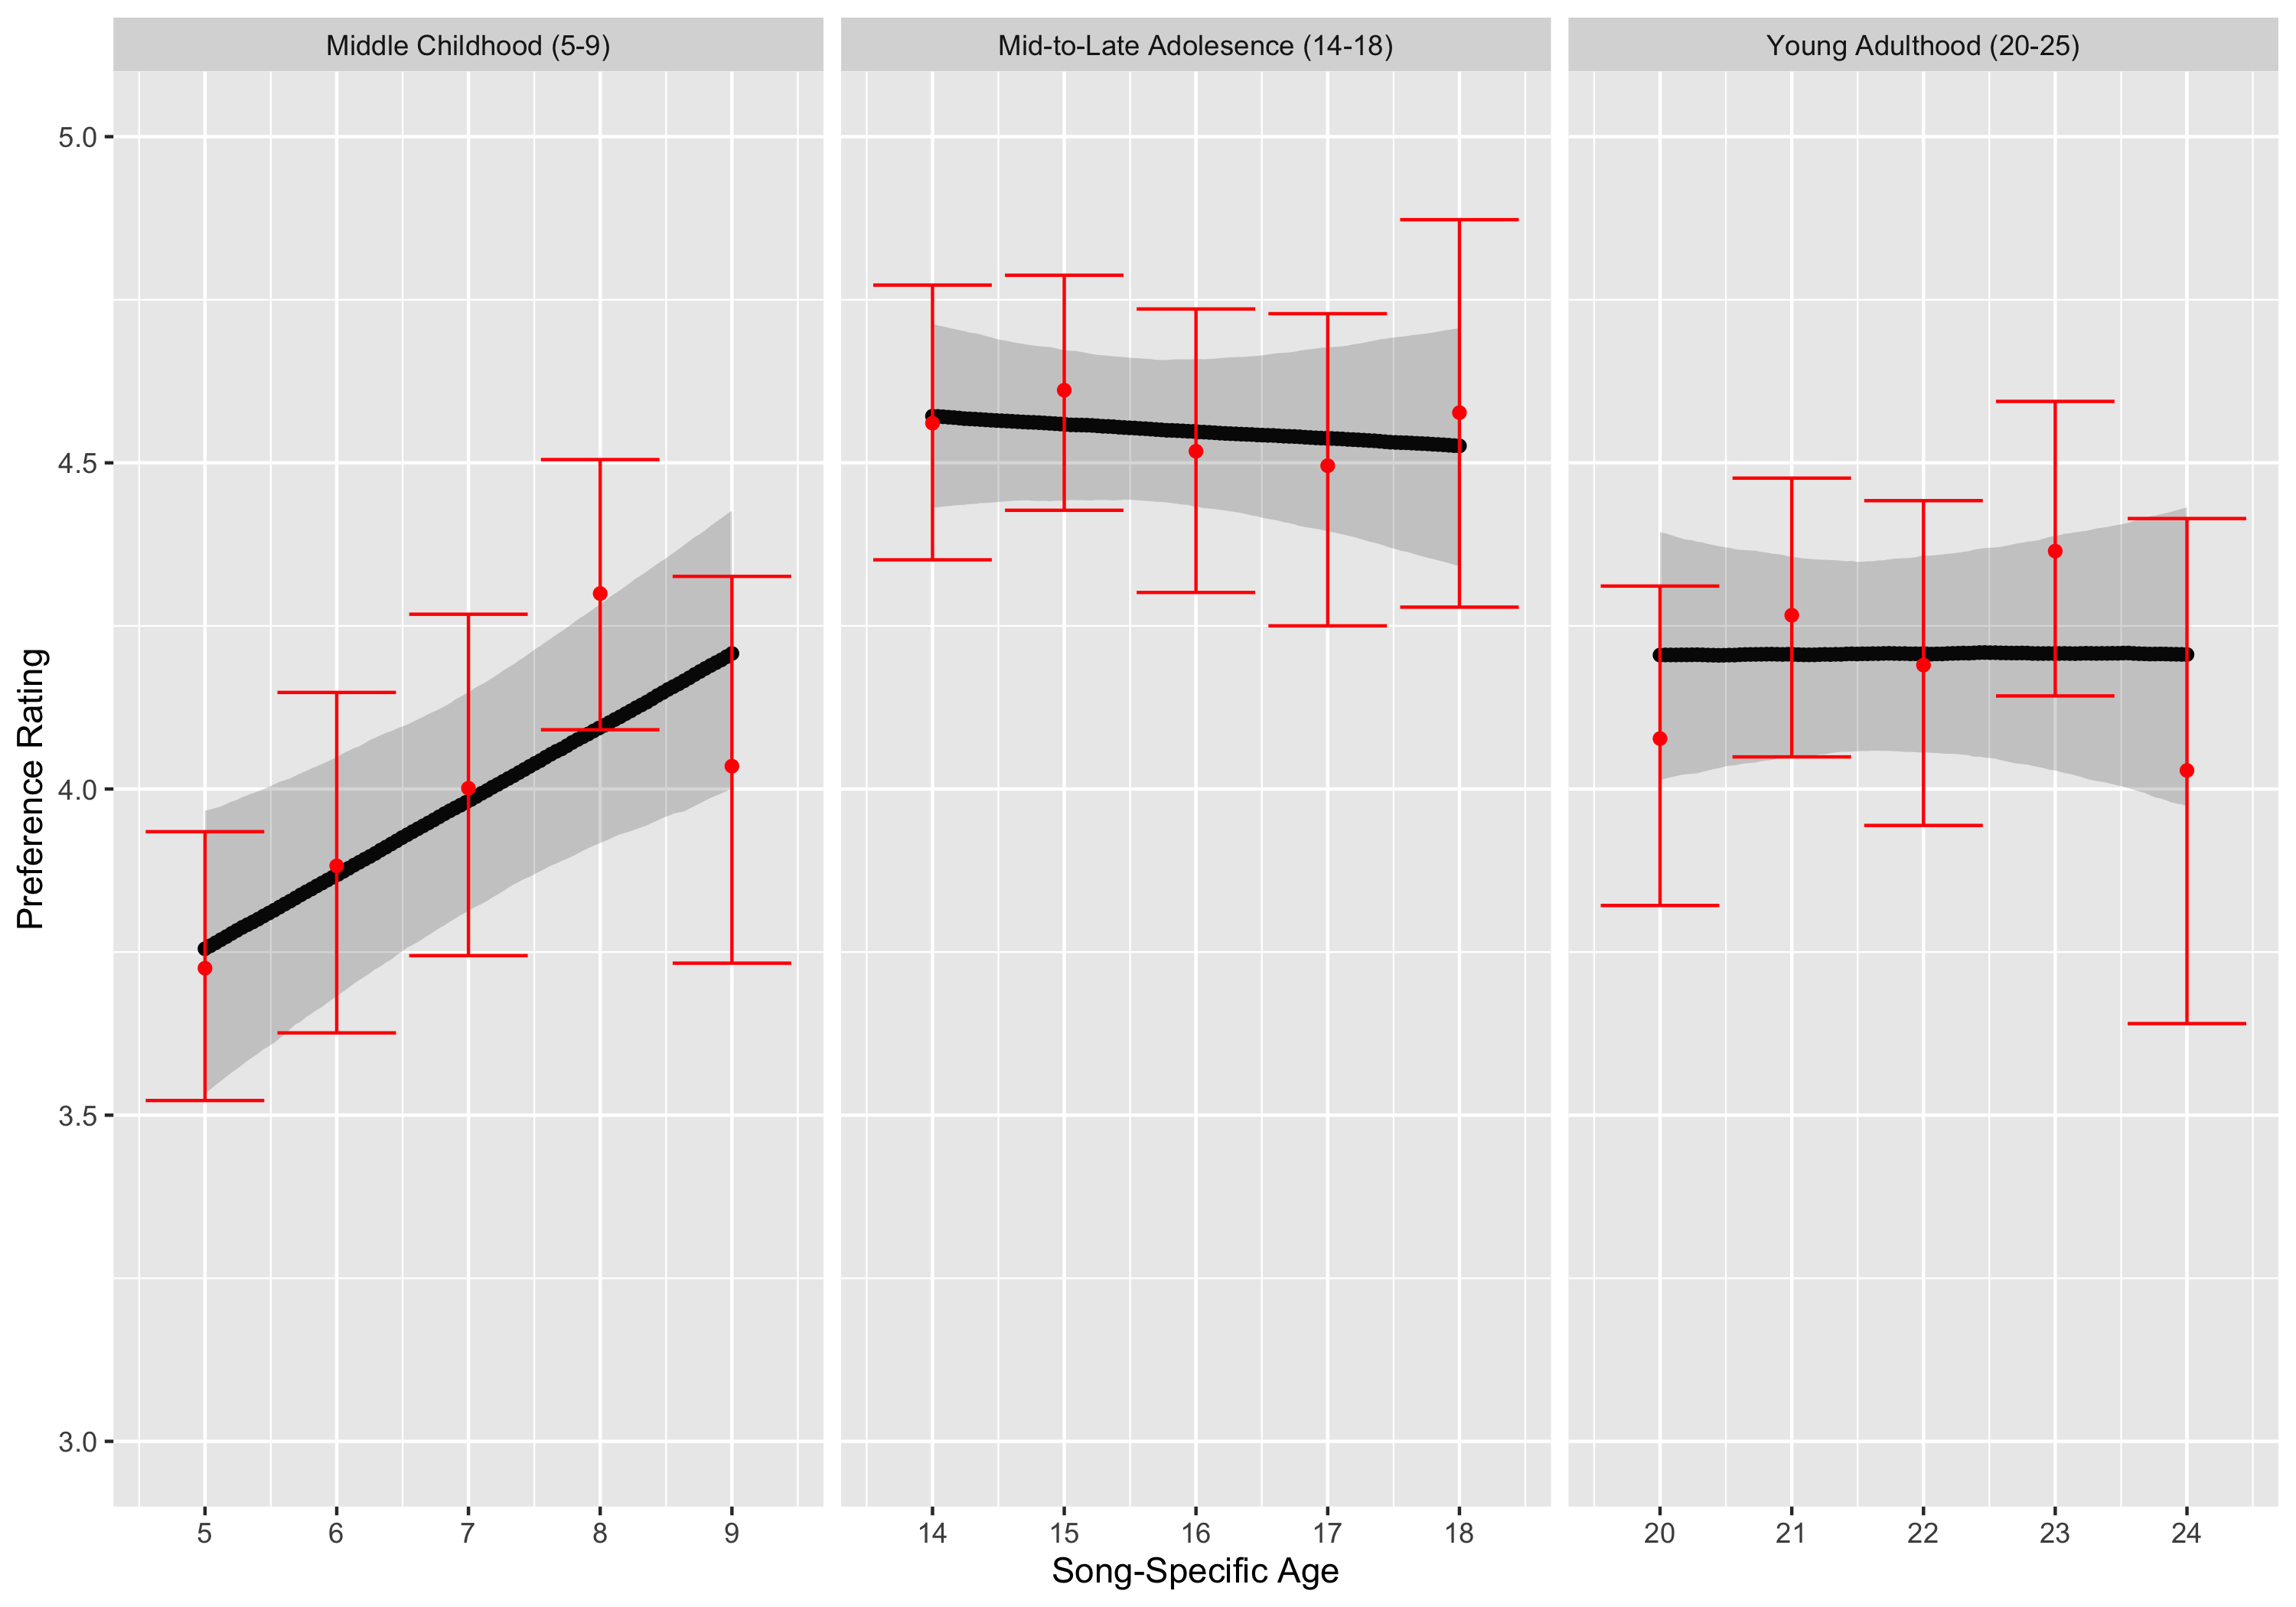
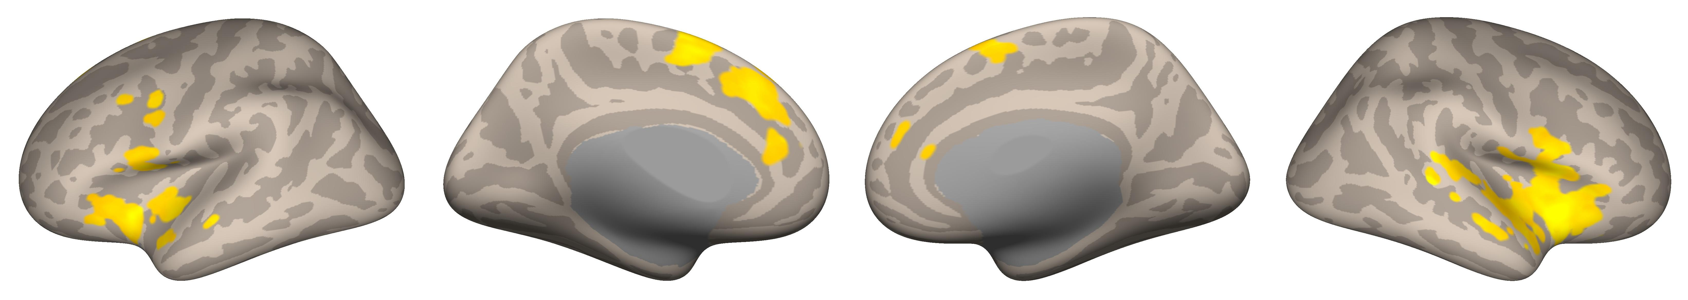
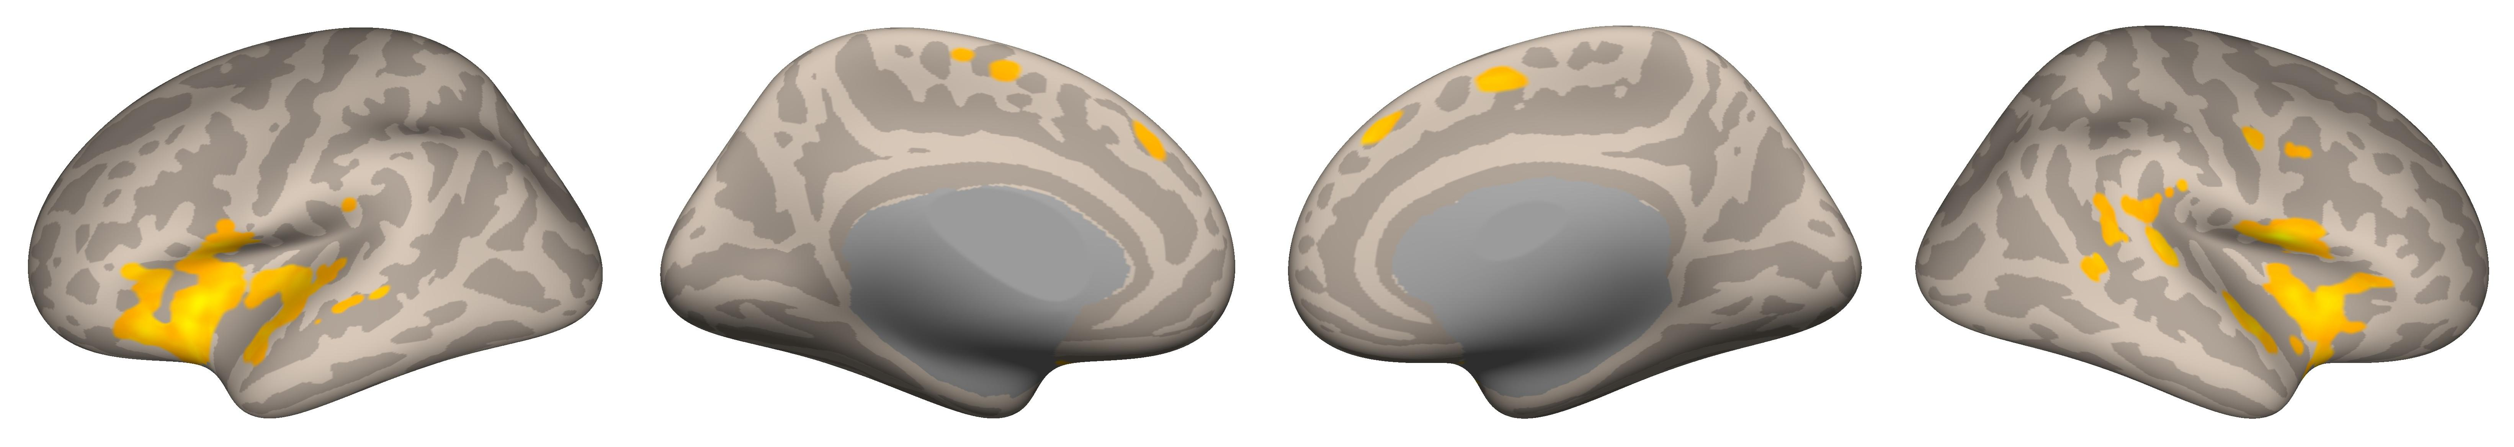
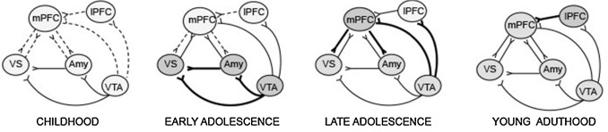
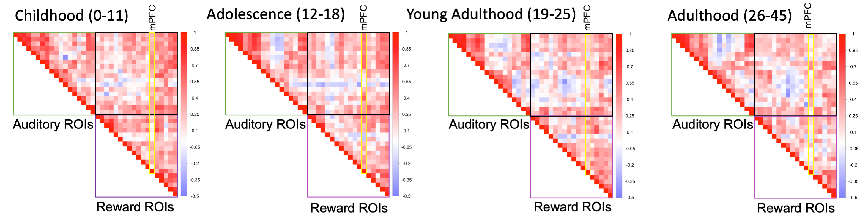
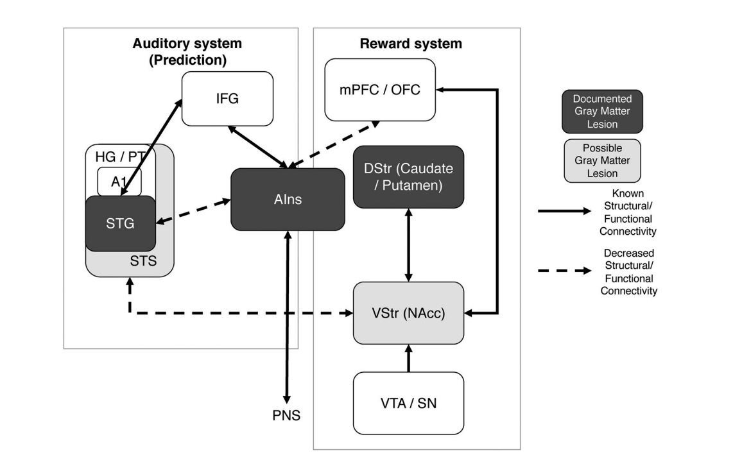
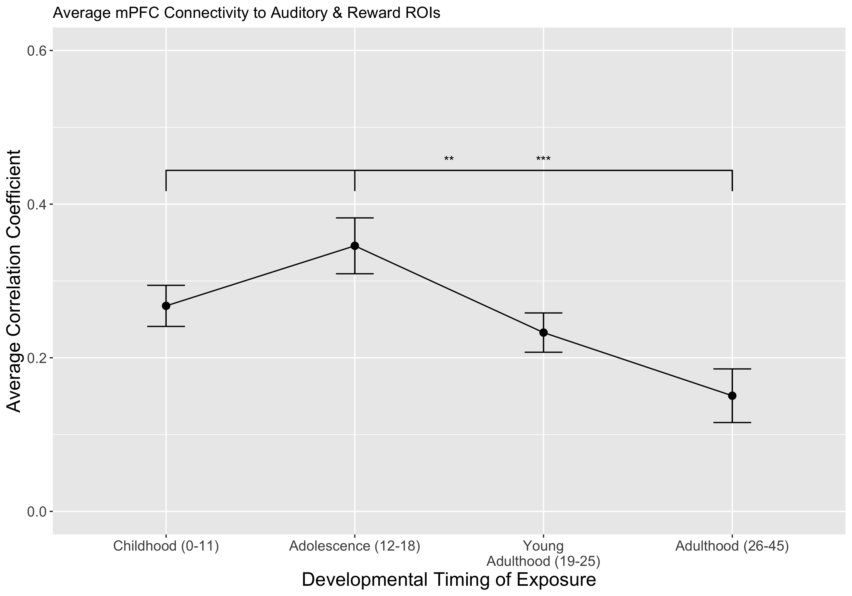
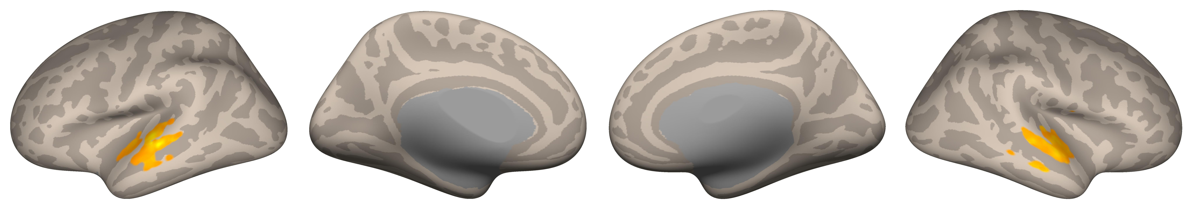
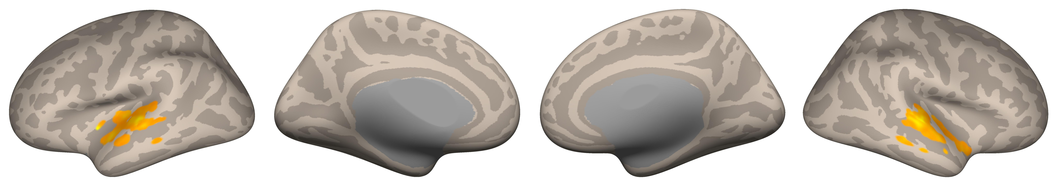

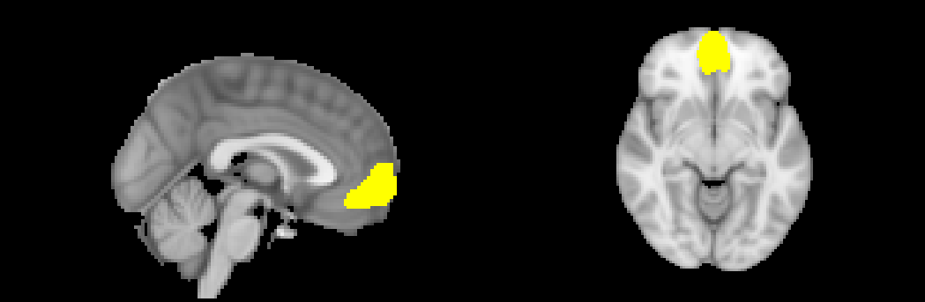
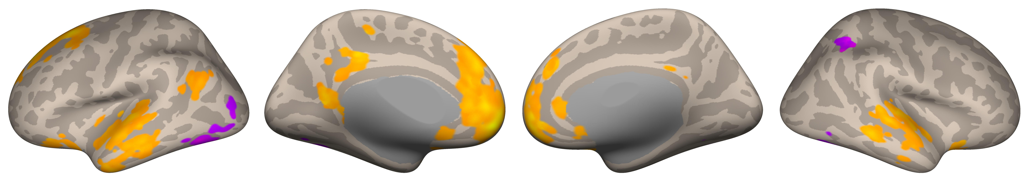
When You Heard it First: Age of Exposure Affects Functional Connectivity between Auditory and Reward Networks
Nicholas Kathios¹, Milena Aiello Quinci¹, Psyche Loui¹
¹Northeastern University
Methods
Anterior Insula Seed-Based Connectivity
Background
Whereas both childhood and adolescent music elicited functional connectivity with auditory areas (STG, Heschl’s Gyrus), childhood music displayed connectivity with dorsal striatum (Putamen), adolescent music did so with the ventral striatum (Nucleus Accumbens)
Music encoded during adolescence may differ in its functional connectivity patterns from that outside this time period, potentially providing neuroscientific insight into the development of lifelong musical preferences
These preferences may reflect improved reward learning in adolescence that persists across the lifespan
Development of the social brain in adolescents may also account for these effects, consistent with the Music for Social Bonding hypothesis⁶
Future Directions: Cross-sectional & longitudinal music-listening fMRI studies; investigation of age-related differences on music reward-learning paradigms; SSA fMRI analyses in clinical populations
Rubin, D. C., & Schulkind, M. D. (1997). The distribution of autobiographical memories across the lifespan. Memory & Cognition, 25(6), 859–866. https://doi.org/10.3758/BF03211330
Casey, B. J., Getz, S., & Galvan, A. (2008). The adolescent brain. Developmental Review, 28(1), 62–77. https://doi.org/10.1016/j.dr.2007.08.003
Steinberg, L., Albert, D., Cauffman, E., Banich, M., Graham, S., & Woolard, J. (2008). Age differences in sensation seeking and impulsivity as indexed by behavior and self-report: Evidence for a dual systems model. Developmental Psychology, 44(6), 1764–1778. http://dx.doi.org/10.1037/a0012955
Casey, B., Galván, A., & Somerville, L. H. (2016). Beyond simple models of adolescence to an integrated circuit-based account: A commentary. Developmental Cognitive Neuroscience, 17, 128–130. https://doi.org/10.1016/j.dcn.2015.12.006
Belfi, A. M., & Loui, P. (2020). Musical anhedonia and rewards of music listening: Current advances and a proposed model. Annals of the New York Academy of Sciences, 1464(1), 99–114. https://doi.org/10.1111/nyas.14241
Savage, P. E., Loui, P., Tarr, B., Schachner, A., Glowacki, L., Mithen, S., & Fitch, W. T. (2021). Music as a coevolved system for social bonding. Behavioral and Brain Sciences, 44. https://doi.org/10.1017/S0140525X20000333
We acknowledge support from Grammy Foundation, NSF-CAREER 1945436, NSF-STTR 2014870, and Kim and Glenn Campbell Foundation.
Older adults tend to recall a disproportionately high number of autobiographical memories from their adolescence and young adulthood compared to any other time across the lifespan (the “reminiscence bump”)¹
This population recalls more autobiographical memories in response to music from this time and show lifelong preferences for this music:
Adolescents display increased sensitivity to reward and risky behavior, which has been attributed disproportionate maturation of subcortical limbic regions in comparison to frontocortical regions^{2,3}
Pleasurable music listening experiences involves an interaction between and within the auditory and dopaminergic reward systems, facilitated by the anterior insula:⁵
Taken together, these models suggest increased preference for music from one’s adolescence might, in part, reflect increased connectivity between the mPFC and VStr that persists across the lifespan
Hypothesis: Music first heard in listeners’ adolescence will show functional connectivity patterns between the mPFC and reward circuitry
18 cognitively healthy older adults (ages 54-89; M=66.6)
10/18 participants completed a follow-up interview in which they reported when they thought they first heard familiar clips
Every familiar clip was categorized via developmental exposure (childhood [0-11], adolescence [12-18], young adulthood [19-25], and adulthood [26-45]), we subtracted the year in which the participant was born from the year in which the stimulus was first released (Song-Specific Age)
We utilized participants’ self-report for self-selected music from before they were born
fMRI data were acquired using a Siemens Magnetom 3T MR. Continuous acquisition was used for 1440 volumes with a fast TR of 475 ms. Forty-eight axial slices were acquired as echo-planar imaging (EPI) functional volumes covering the whole brain (voxel size = 3 x 3 x 3 mm³).
Data were preprocessed and analyzed using SPM12 (Statistical Parametric Mapping) software and the CONN Toolbox.
Music first heard during adolescence and young adulthood showed activation in auditory areas (STG, MTG, Heschl’s Gyrus)
Music first heard during adolescence showed functional connectivity with auditory (MTG, STG) and reward areas (ventral & dorsal striatum, insula, orbitofrontal cortex)
Childhood (0-11):
Adolescence (12-18):
Voxel Threshold: p-FDR corrected <0.05; Cluster Threshold: p FDR-corrected <0.05
Music from young adulthood (19-25) and adulthood (26-45) did not survive corrections
ROI-ROI Connectivity Matrices
Univariate Main Effect of Age of Exposure
Adolescence (12-18):
Young Adulthood (19-25):
Discussion
Voxel Threshold: p-FDR corrected <0.05; Cluster Threshold: p FDR-corrected <0.05
Music from childhood (0-11) and adulthood (26-45) did not survive corrections
mPFC Seed-Based Connectivity
Adolescence (12-18):
References
Voxel Threshold: p-FDR corrected <0.05; Cluster Threshold: p FDR-corrected <0.05
Music from childhood (0-11), young adulthood (19-26), and adulthood (26-45) did not survive corrections
Notes:
In this secondary analysis, I looked at a data set in which 18 cognitively healthy older adults completed an fMRI music listening task in which they listened to either self-selected or other-selected music. For each stimulus heard in the scanner, I calculated song-specific age, a measure of how old participants were when a specific song was released. Because this sometimes leads to negative ages, I also conducted follow-up interviews in which I asked participants to self-report when they first heard these songs. I then categorized these songs based on SSA per participant: Childhood (0-11), Adolescence (12-18), Young Adulthood (19-25) and Adulthood (26-45)
VOXEL HEIGHT CLUSTER SIZE

